Slide 1
NCFDD: Every Semester AND Summer Need a Plan
Wayne State University
Krista Brumley
May 8, 2019
*Resource: The National Center for Faculty Development and Diversity (www.facultydiversity.org)

Slide 2
Why create a strategic plan?
As academics we have a lot of unstructured time
Varied and time-consuming commitments
The tendency to unconsciously prioritize seemingly urgent, unimportant tasks and other needs while neglecting our own long-term success, health and well-being, and relationships
Research unlike teaching and service has very little built-in accountability (daily; instead it is maybe once a year or after five years when you are ready to go up or would like to be promoted)
The strategic plan is meant to build in accountability and elevate its importance
Lack of clarify about how much time research and writing tasks actually take (2.5 times more)
Institutional cultures/department norms on what work means and when we do it (i.e., “everyone works all the time”)

Slide 3
Plan for Today: To Create a Strategic Plan (i.e., your navigation plan)
1. Identify your goals for semester (summer)
2. Map the steps (only research/writing/personal; not other items because built-in accountability)
3. Projects meet calendar – this is your strategic plan
4. Weekly planning meeting – maintain the strategic plan
5. Align time with priorities – tasks meet calendar
6. Identify your resistance; evaluate
7. Assess and adjust

Slide 4
Begin recorded webinar (January 10, 2019)
(29 minute marker)
Available on the NCFDD site once you log in

Slide 5
Step 1: Identify your Goals (39 minutes)
Make sure they are SMART:
Specific (simple and clearly defined)
Measureable (tangible evidence that you’ve achieved it)
Attractive (you have to somewhat want to do it)
Realistic (to be successful)
Time-framed (balance some urgency with a clear plan)

Slide 6
Step 2: Map the Steps (time 47.15-52.22 -- reviewed; switches to blank template at 57 min.; voice back on at 1.02)
Introduction
Submit WFC Manuscript to Journal
Literature review
Methods
Perceived WFC
Gendered differences
Code interviews
Analysis
Pull out quotes

Slide 7
Step 2: Map the Steps – your turn (10 minutes)
Project level
GOAL
Project
Project
Task level
Task
Project

Slide 8
Step 3: Projects meet Calendar (this is your strategic plan) (1.05 time)
Week | Writing/Research Project(s) | Personal
Week 1 | Introduction – WFC (project from goal 1) | Example: Aqua fit (2/week)
Week 2 | Introduction - WFC | Example: Walk 1 mile/day
Week 3 | Literature review – WFC Edits on nights away paper (project from goal 2) | Example: Read fiction for 30 minutes/evening
Week 4 | Literature review – WFC Edits on nights away paper | Take kid to soccer practice
Week 5 | Literature review – gendered differences
Week 6 | Conference travel/Vacation/?
Week 7 | Literature review – gendered differences - WFC
Week 8 | Analysis - WFC
Week 9 | Analysis - WFC
Week 10 | Analysis – finish; start conclusions -WFC
Week 11 | Conclusions - WFC
Week 12 | Final read and submit - WFC

Slide 9
Step 3: Projects meet Calendar (this is your strategic plan) (1.10 time starts; 1.16 blank template up; 1.19.50 Rachel is back) – your turn
Week | Writing/Research Project(s) | Personal
Week 1
Week 2
Week 3
Week 4
Week 5
Week 6
Week 7
Week 8
Week 9
Week 10
Week 11
Week 12

Slide 10
The weekly planning meeting!!
(Pause at 1.21)
Webinar talks about next steps on getting the support you need

Slide 11
Step 4: The Weekly Planning Meeting (maintaining the strategic plan)
Set up skeleton rubric (i.e. calendar – paper, electronic, whatever works):
Pull out your weekly calendar; block out all personal (e.g. aerobics class; kid’s soccer game) and professional time commitments (e.g., meetings, workshops) – these are fixed responsibilities that you cannot move
2. Brain dump – categories of responsibilities (e.g., research, teaching, service, personal, coursework, DGS, journal editor, advising/mentoring, etc.)
Write down everything that you need to do this week in each category
Don’t forget your strategic plan – this was your research/writing/coursework
What are your priorities? Consider how you are evaluated!

Slide 12
Sample Brain Dump
Research/Writing | DGS | Teaching | Gender & Society | Personal
Read nights away manuscript | Prep for workshop ☺ | Write DQ – 2300 | 1234 | Robotics
Revise demographic chart – GWF project | Send out invite to open house | Grade blogs – 7800 | 5678.r1 | XC meet
Send out transcripts | Revise recruitment flyer | Write intro., week 5 – 2300 | 9101 | Exercise – aqua fit, walk, run, etc.
Draft introduction | Set up area meetings | Prep for class – 7800 |  | School meeting
Finish coding |  | Grade DQ – 2300
Quotes in WFC chart

Slide 13
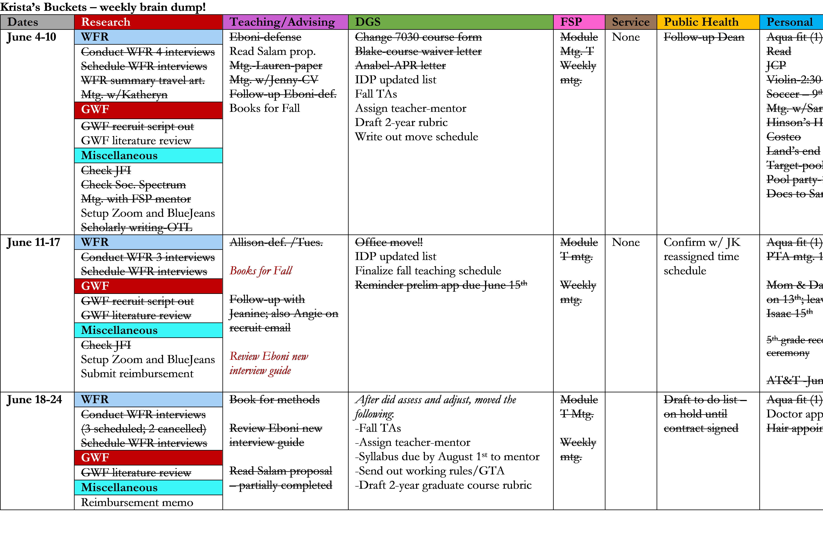
Reality Brain Dump

Slide 14
Step 5: Tasks Meet Calendar (Time)
Place your tasks into your calendar – into a specific day and time
They are NOT all going to fit, so put the most important ones in FIRST! These are the items that contribute to your long-term success
Figure out what do with the tasks that don’t fit:
Delegate, let things go, lower your standard on perfection, ask for help, renegotiate a deadline, etc.
Figure out what matters; leave white space so not all jammed; be creative

Slide 15
Step 5: Tasks meet Calendar (align your priorities with how evaluated)

Slide 16
Recommended next steps (1.21 min. on recorded webinar)
Watch “How to align your time with your priorities” video – weekly planning meeting
Watch “How to develop a daily writing practice” video
Find an accountability buddy (NCFDD) or a colleague
If a grad student, consider dissertation success bootcamp; its free!
Watch “Mastering academic time management” video
Watch “Moving from resistance to writing” video – June 13th
Join the 14-day writing challenges – starts June 17th
Check out the teaching in no time videos
https://www.facultydiversity.org/events
https://www.facultydiversity.org/core-curriculum

Slide 17
GOOD LUCK THIS SUMMER!
And don’t forget to assess and adjust around week 6 or 7 of the summer…

Slide 18
Step 6: Identify and Evaluate your Resistance (what is it, what drives it, and how do we do resistance?)
Resistance: a defense mechanism to keep us from doing anything that might be dangerous; it arises in response to anything that increases our anxiety.
Fear of: exposure, failure, challenging the status quo, not being enough, etc.
How it manifests?
- Procrastination (or sometimes known as “workcrastination” like email ☺)
- Avoidance
- Denial
- Anger
- Limiting beliefs

Slide 19
Step 6: What are limiting beliefs?
Limiting Beliefs about Writing | What we Know from Research
I need huge blocks of uninterrupted time. | The most productive writers write regularly, in small increments.
I must be inspired to write. | No, you don’t. You show up, the inspiration comes once you get started.
Writing is what I do when I’m done thinking. | Writing is thinking.

Slide 20
Step 7: Assess and adjust!
Each week is a new week!!
How am I progressing towards my goals in my strategic plan?
Have I developed a consistent daily writing habit?
Am I consistently holding a weekly planning meeting?
If I’m not where I hoped to be, what’s holding me back?

Slide 21
Step 7: What’s holding you back?
Technical Errors | Psychological Errors | External Realities
Haven’t set aside the time to write | Perfectionism | Somebody got sick
Set aside the wrong time | Disempowerment | You get sick
You have no idea how much time tasks take | Inner critic(s) | You have a health issue
You don’t have smart goals | Unclear goals | You move
You can’t figure out what you have to do | Imposter syndrome | You had a baby
You don’t know how to do something | Fear of failure
 | Fear of success

